Slide 1
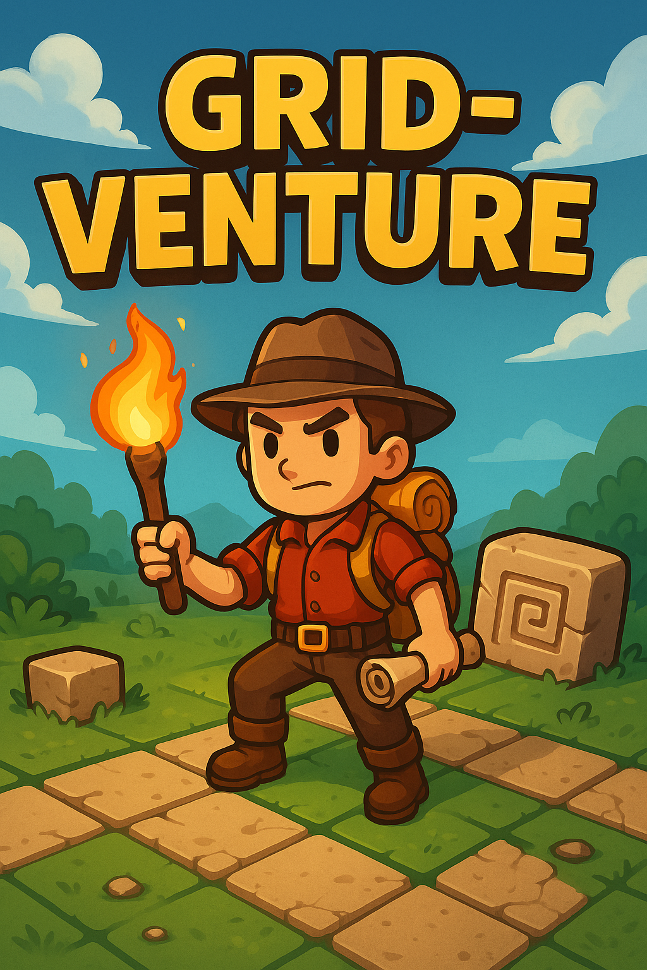
A grid-based mystery adventure game powered by a full-stack MERN application
Developers:
Ian Kessack & Noela Deane

Slide 2

What is Grid-Venture?
What inspired it?
Notes:
What is Grid-Venture?
A grid-style exploration game where players uncover clues and interact with the environment.
Users must navigate terrain, unlock paths, collect tools, and uncover secrets..
Grid-Venture is designed to combine classic RPG exploration with a full-stack engineering challenge. It's for users who love discovering, unlocking, and progressing in interactive environments.

Slide 3
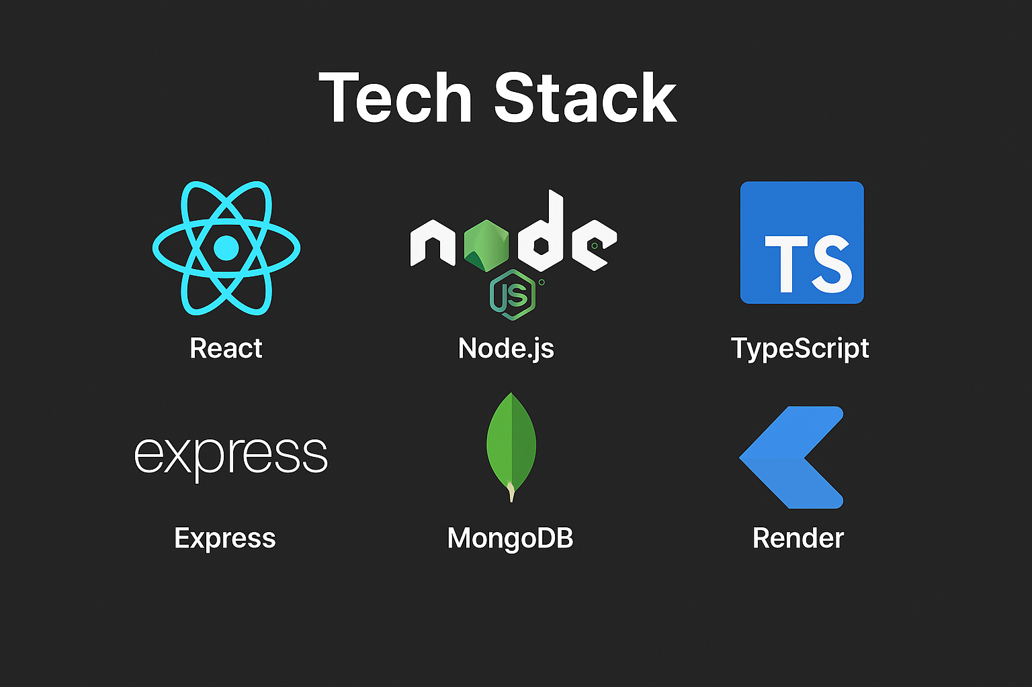
Notes:
Frontend (React + Vite, Tailwind CSS, Axios, Hosted on Vercel)
Backend (Node.js + Express, TypeScript Controllers, JWT Auth, Mongoose ODM; [library for compass] MongoDB Atlas, Hosted on Render.
Frontend and backend was deployed separately to allow the application to function seamlessly.

Slide 4
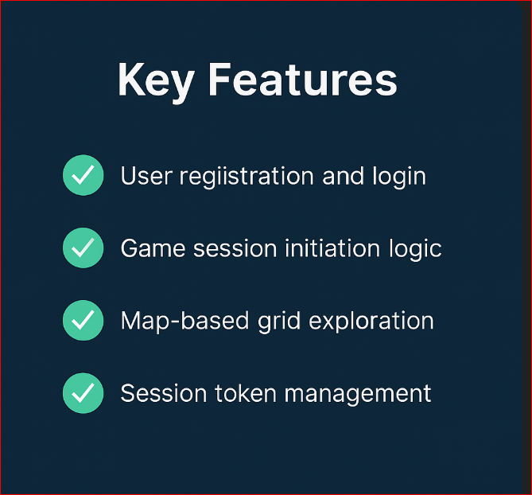
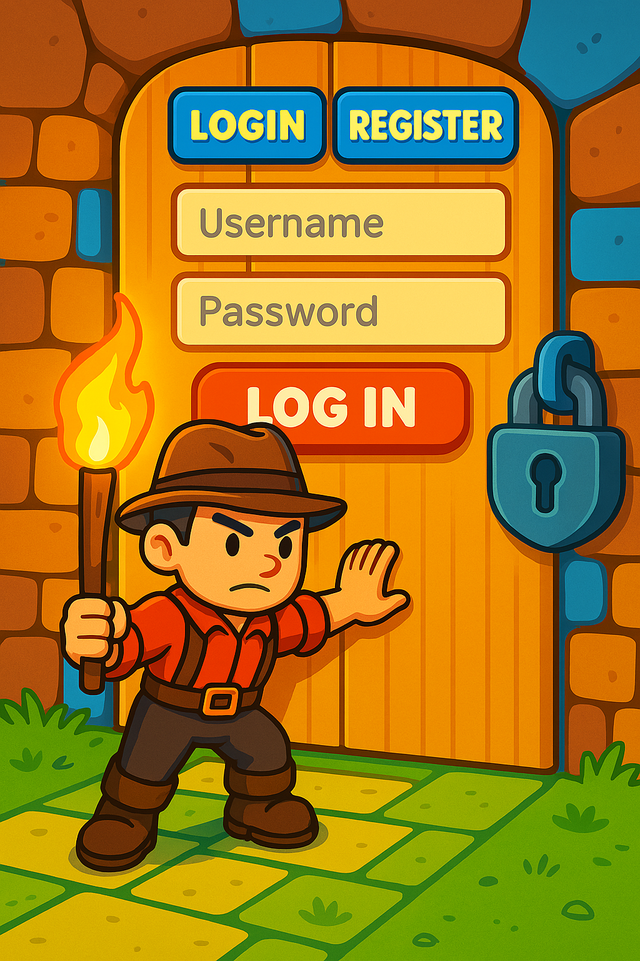
🔐 User Authentication
Notes:
🔐 User Authentication (JWT login/register system)
🧩 Tile-Based Exploration(Visibility logic (fog-of-war) Grid tile types: path, trees, rocks, items

Slide 5
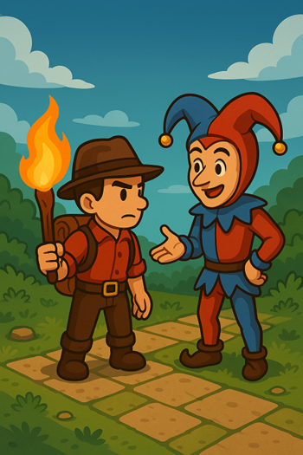
Core Features…..
🧠 Game State Logic
🛠️ Pick up tools
🛠️ Unlock areas
🛠️ Interact with NPCs
🛠️ Interactive inventory
🛠️ Earn explorer points
Notes:
🔐 User Authentication (JWT login/register system)
🧩 Tile-Based Exploration(Visibility logic (fog-of-war) Grid tile types: path, trees, rocks, items

Slide 6


Demo Flow
Adventure Complete!
Start a new game session
Use WASD keys to explore
Press E to interact game and NPC
Register or
log in
Pick up inventory items keys, tool, ect
Player unlocks new paths to gain explorer points

Slide 7
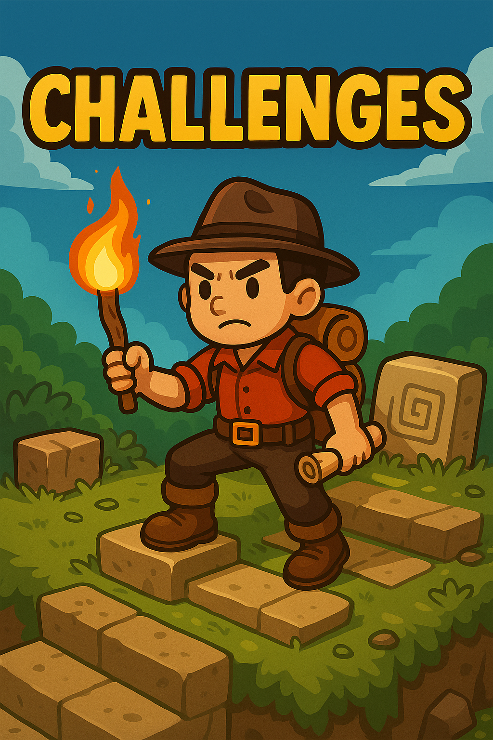
✅ Building deep expertise with technology
✅ Overcoming deployment hurdles
✅ Handling authentication securely

Slide 8

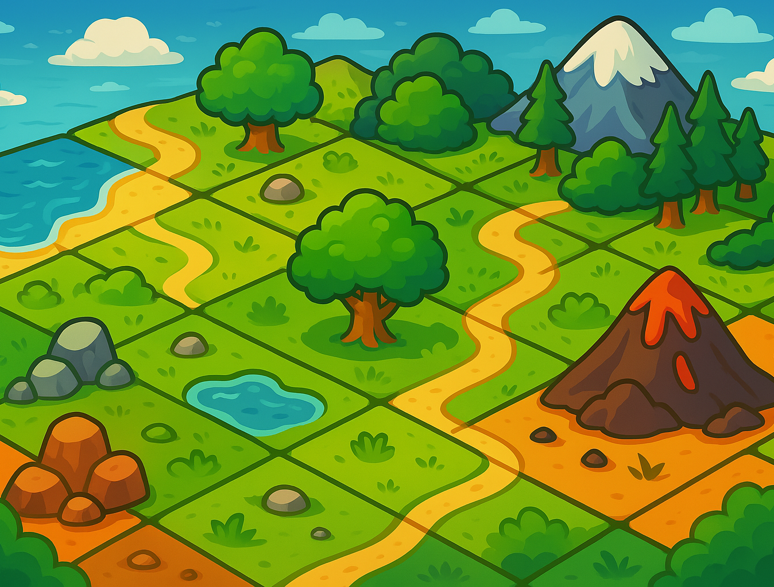
In-game store
More interactive maps
New NPC Quest

Slide 9

Ian Kessack iankessack1989@gmail.com Noela Deane Noeladnelson@gmail.com
Developed by :
URL https://grid-venture-ruby.vercel.app/
Copyright (c) 2025 NoelaDeane, IanKessack

